Slide 1
4 GPU performance analysis

Slide 2
Modification to LeNet model
Added additional fully connected layer.
Pooling layer cannot be placed alone in a diff split. (graph error, maybe because layer has no actual parameters)
Architecture is now conv1->pool1->conv2->pool2->fc1->fc2->sm1
2.7 million params approx. (earlier 763000)

Slide 3
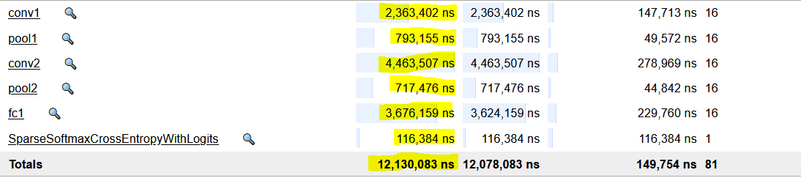
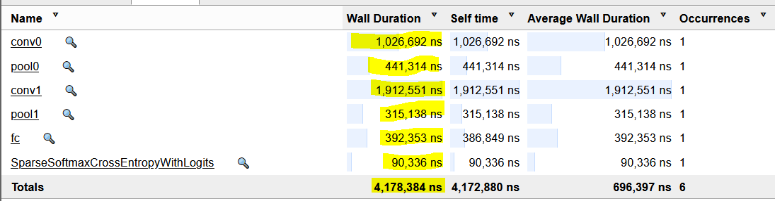
What was the problem identified?
Accumulated compute time increased with increase in micro-batch count
Ideally we expect the operation to take 16 times lesser, i.e 1026692/16 ~ 64168

Slide 4
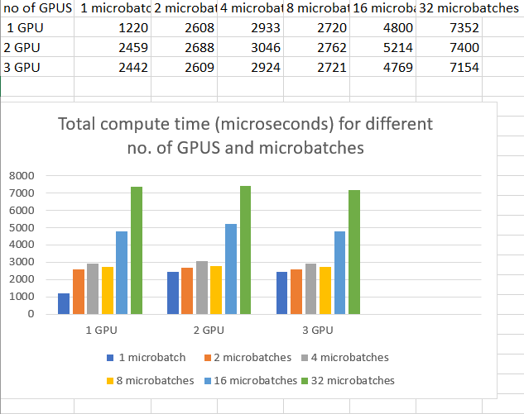
Variations in microbatches
Chose number of microbatches as 1,2,4,8,16,32
Minibatch size = 256
Why the sudden spike for large micro-batch numbers?

Slide 5
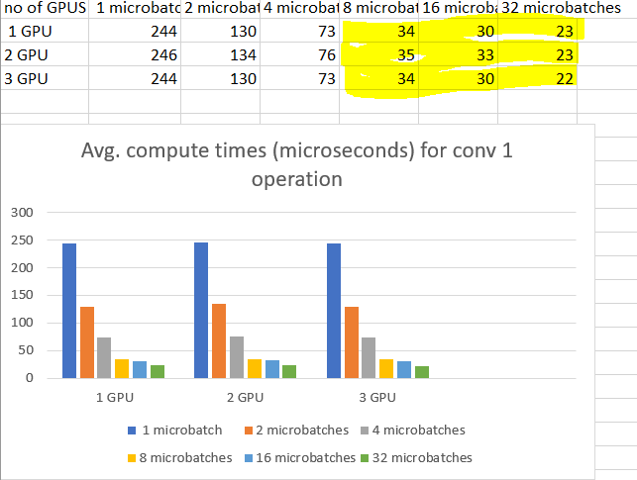
Variations in microbatches
For small micro-batch sizes, the performance does not differ by much

Slide 6
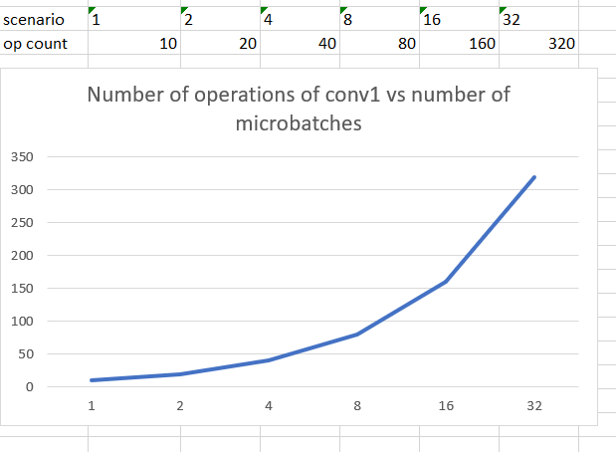
Variations in micro-batches
But the number of operations increases exponentially

Slide 7
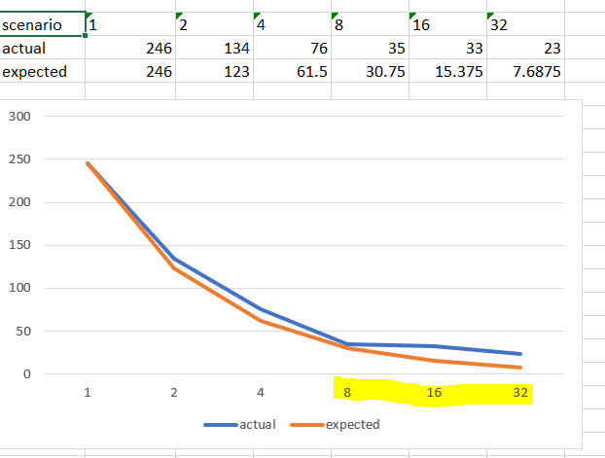
Variations in micro-batches
Dividing further does not improve performance after a point
Correspond to micro-batch size of 16 and 8 respectively

Slide 8
Why flatten?
Kernel has parallel component x that varies with micro-batch size and constant time c (independent of size).
For m micro-batches, time for each is x/m + c
If x/m is already small, then x/2m, x/4m, etc. will also be small and c becomes dominant.

Slide 9
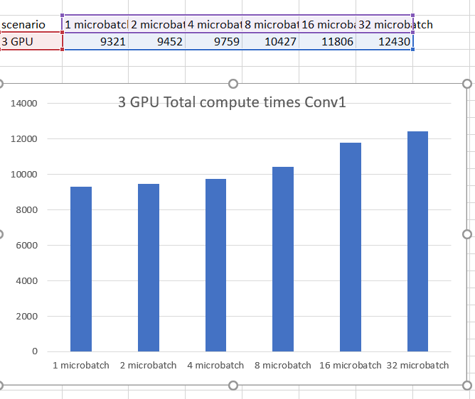
What happens when batch size increases?
Changed to minibatch size of 1024
Rise is not as significant now

Slide 10
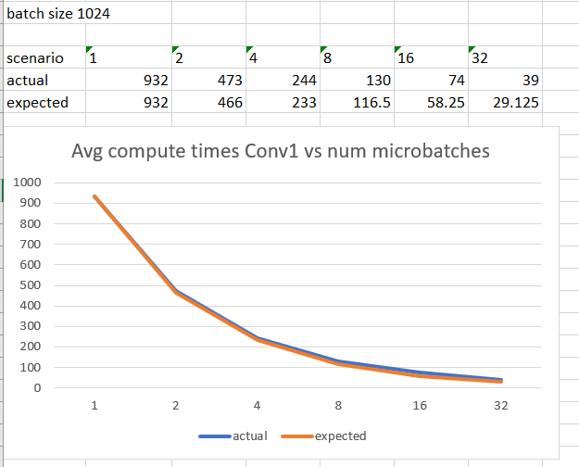
What happens when batch size increases?
Avg compute times also do not flatten out as much

Slide 11
Takeaways
Choose the number of micro-batches in such as way that the size does not go smaller than a limit (32 in this case)
For batch size of 1024, 1,2 and 4 micro-batches give hardly any difference (see previous slides), in the total compute time.
So try to keep the micro-batch size at least 1024/4 = 256 as a safety net. But the number may vary from operation to operation too.

Slide 12
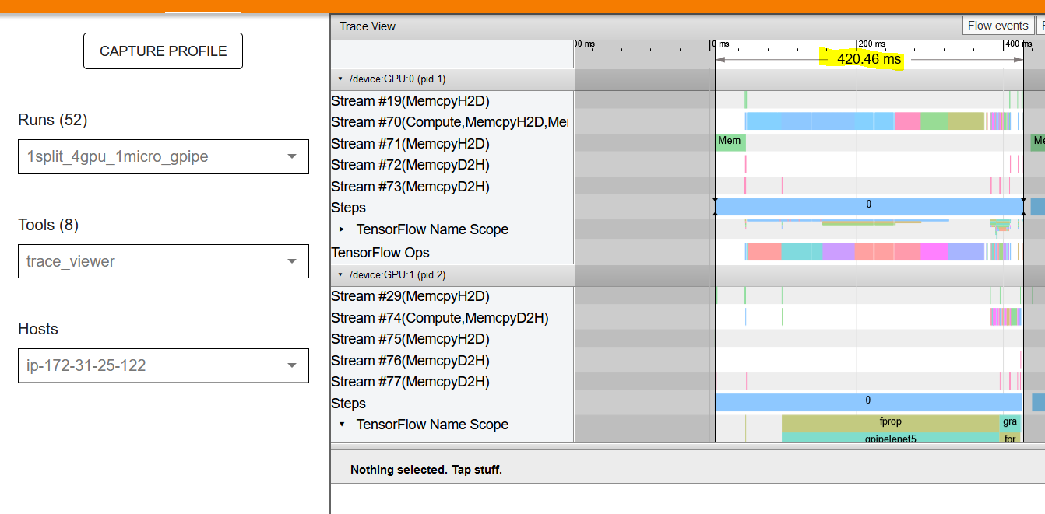
Trace files
Data parallelism (4 GPUS in parallel)
Avg time per minibatch = 105.115

Slide 13
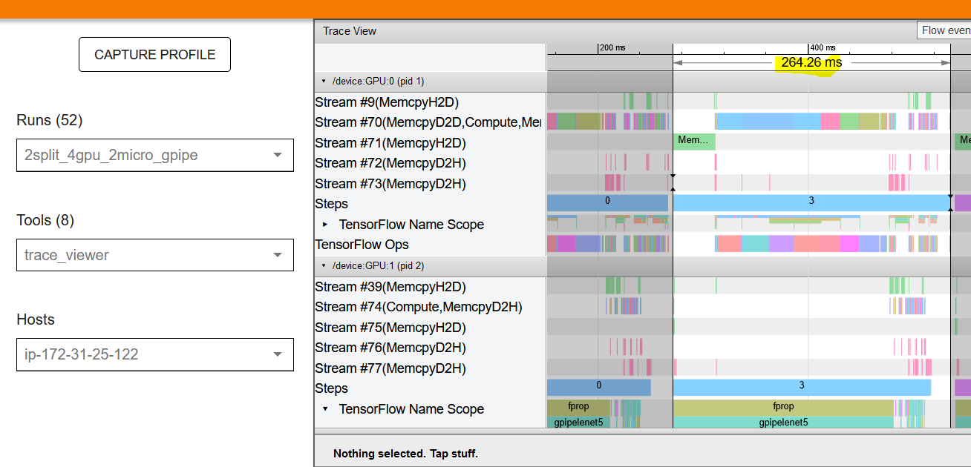
Data + pipeline parallelism
Data + pipeline parallelism (GPUS 1,2 and 3,4 pipeline parallel. But each couple processes a different minibatch in parallel)
Avg time per minibatch = 132.13

Slide 14
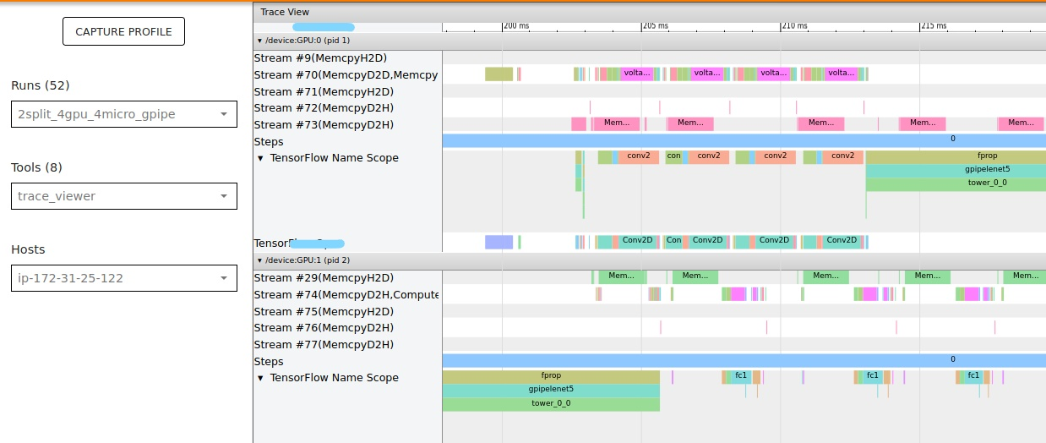
Data + pipeline parallelism

Slide 15
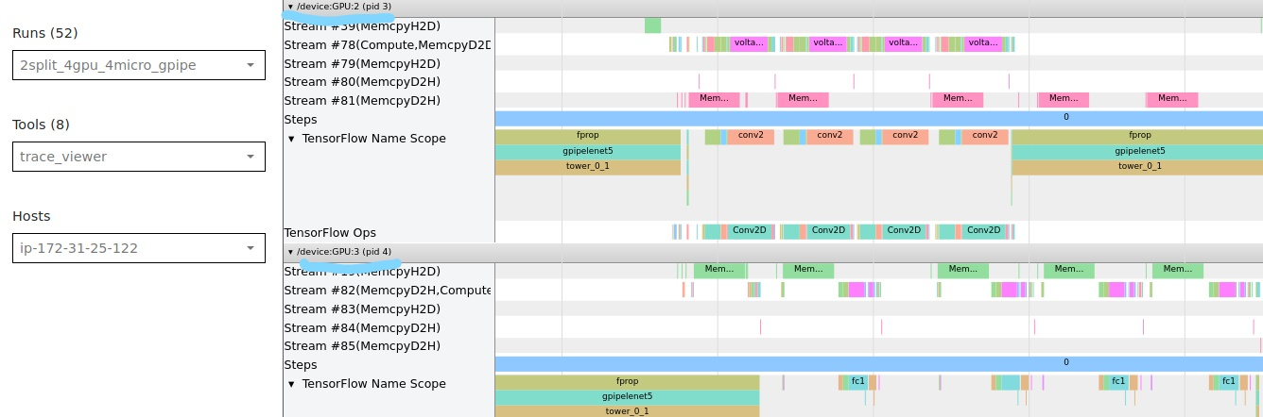
Data + pipeline parallelism

Slide 16
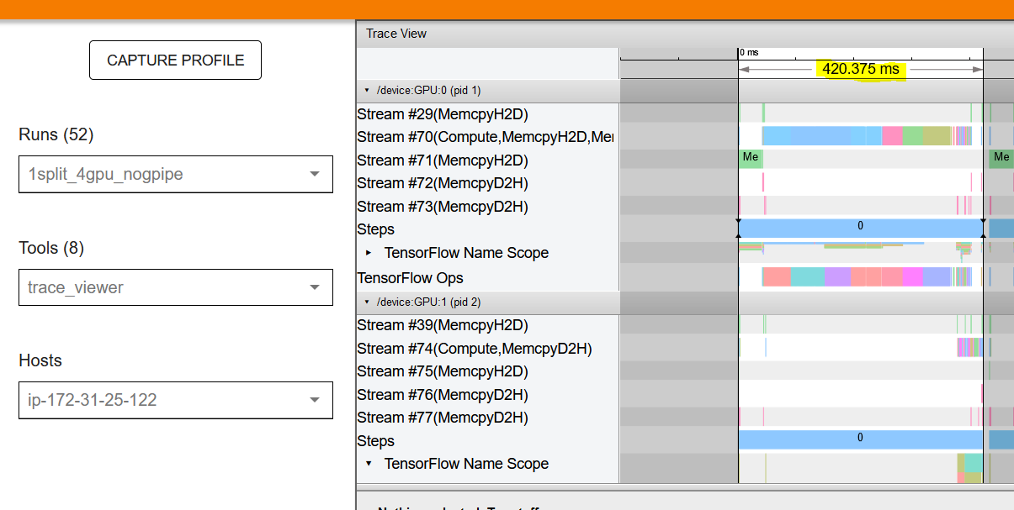
How does this compare with standard case?
One GPU, no GPipe
Avg = 105.09. 4 gpu data parallel

Slide 17
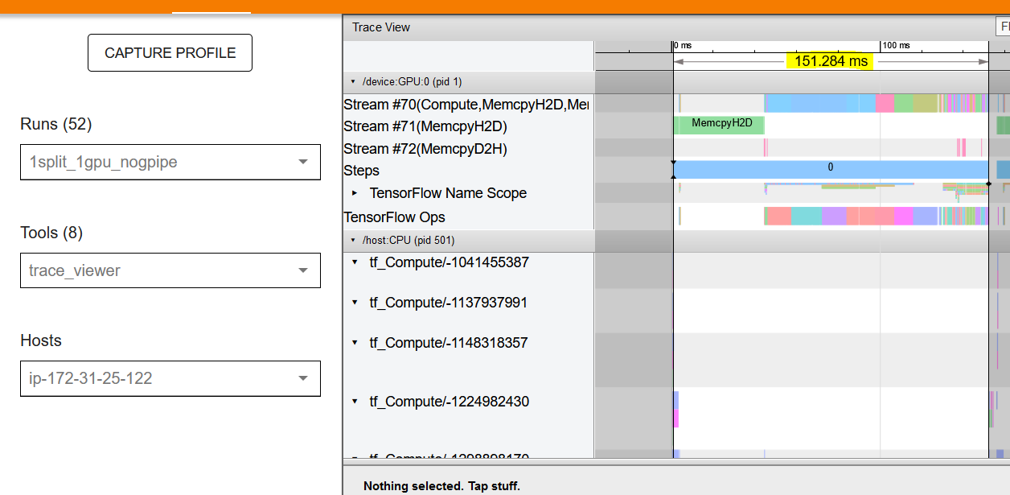
Standard case
Slightly worse than data parallelism

Slide 18
Performance eval (same number of partitions)
Now we can make the total compute times in each layer for both the GPipe and non-GPipe models almost same by choosing appropriate micro-batch size/number
But how does GPipe perform even when this is done?
Ideally pipelining multiple micro-batches across GPUS should be better than pipelining the entire minibatch as one unit across the same number of GPUS.

Slide 19
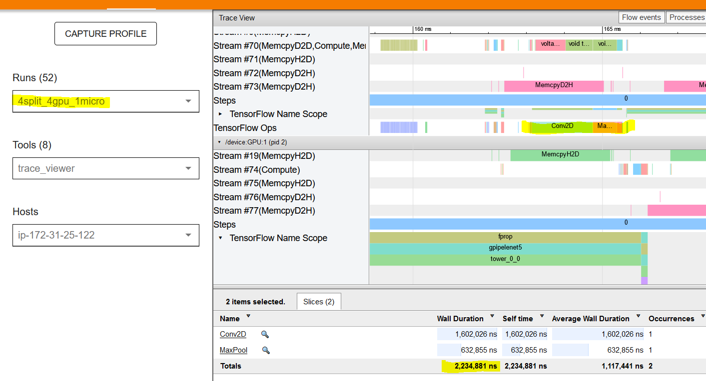
For example..

Slide 20
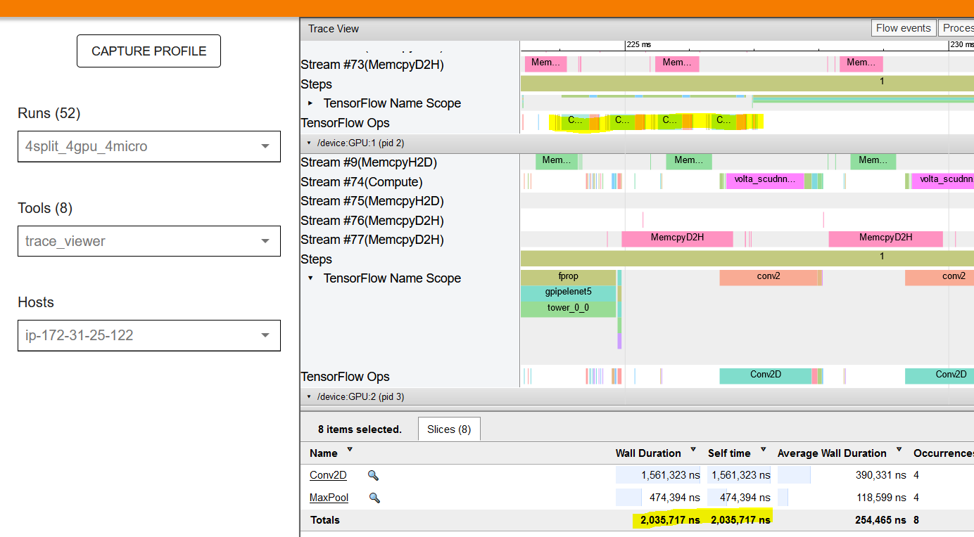
Contd.

Slide 21
Performance eval
So in general the accumulated compute times at each layer are the same. (Some slight difference may be there because different operation can flatten out for different micro-batch sizes.)
But how does their overall performance compare?

Slide 22
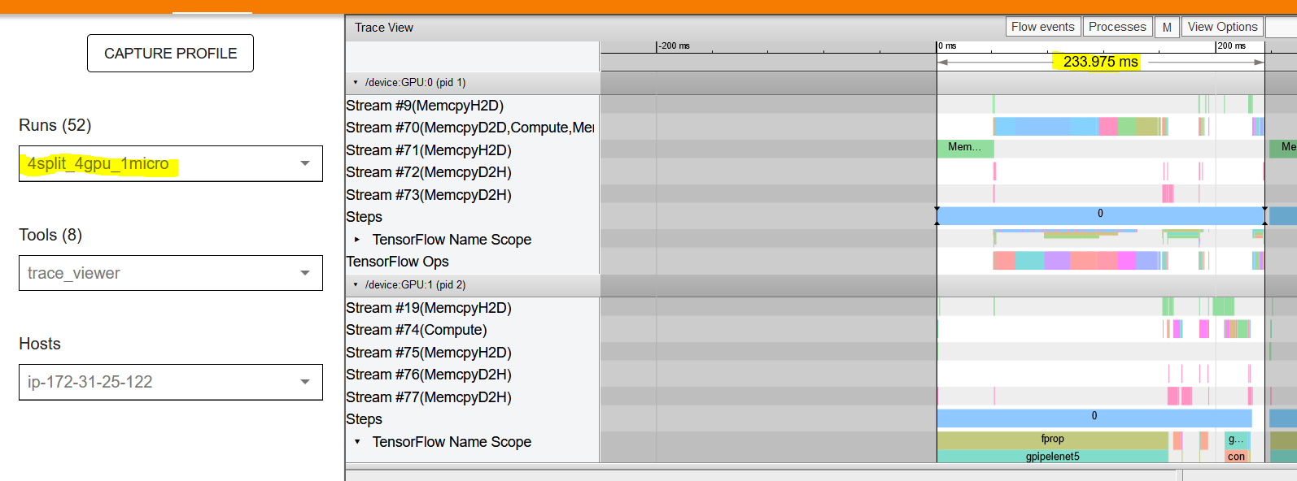
Performance eval

Slide 23
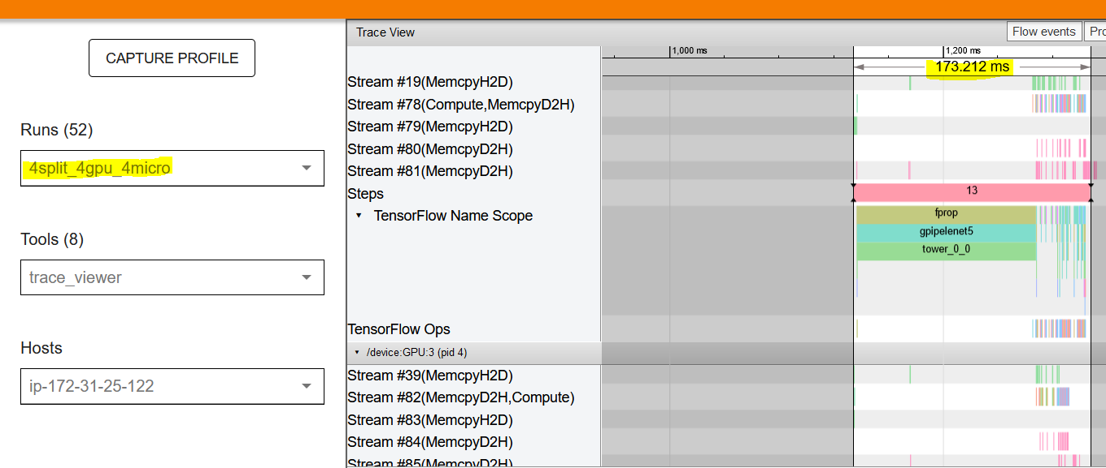
So increasing micro-batch number improves performance for same number of splits as expected

Slide 24
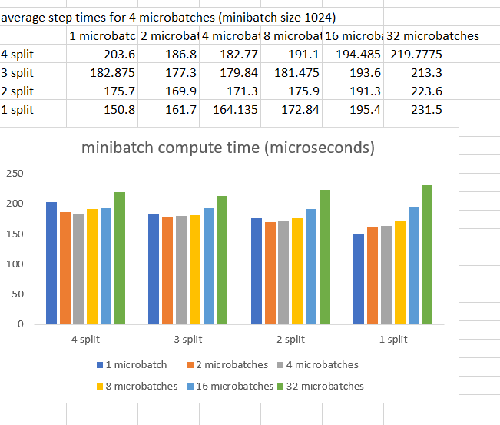
Performance analysis for different splits
Comparing average step times

Slide 25
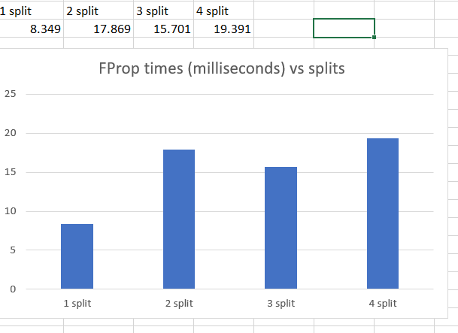
Breaking down operations (4 micro-batch)
Setup times are not differing significantly

Slide 26
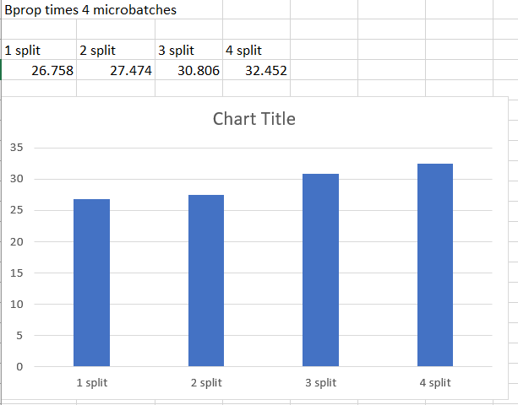

Slide 27
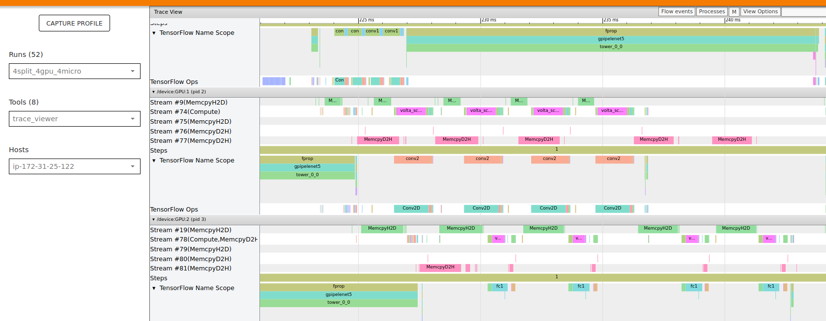
Why does performance worsen with more splits?
First split has almost finished computation for all micro-batches before second even starts. (Poor partitioning)

Slide 28
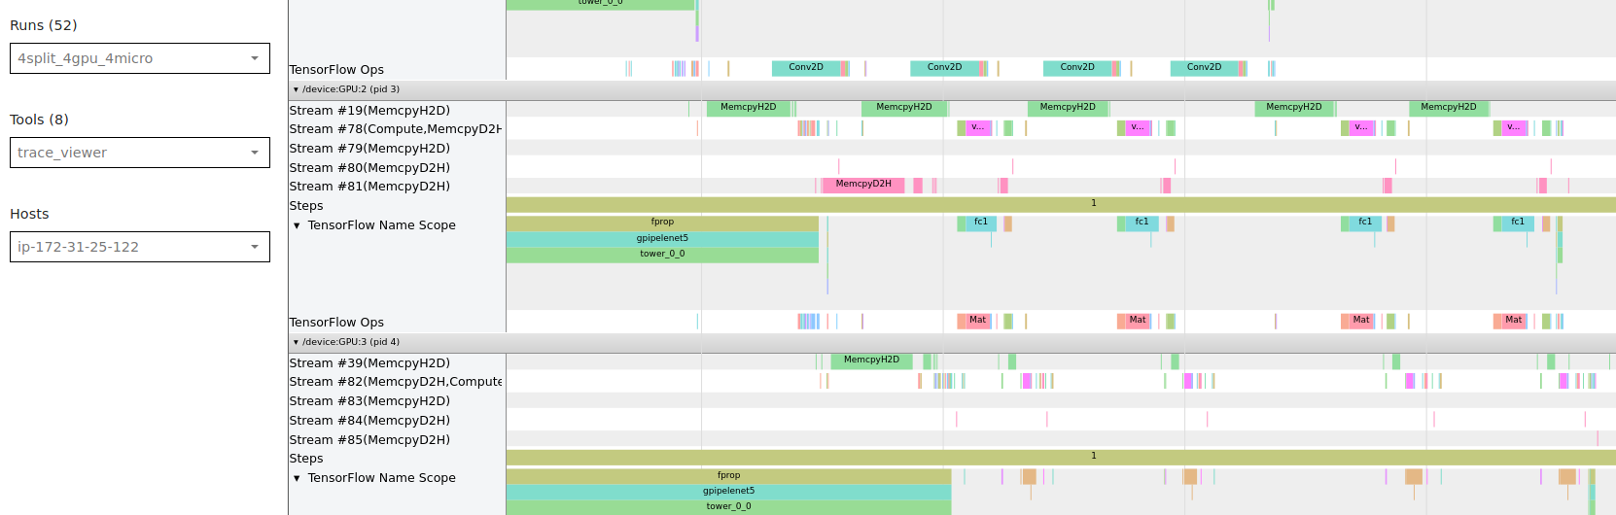
Why does performance worsen with more splits?
Fc2 layer + softmax (too small). Again bad partitioning, but skew is less

Slide 29
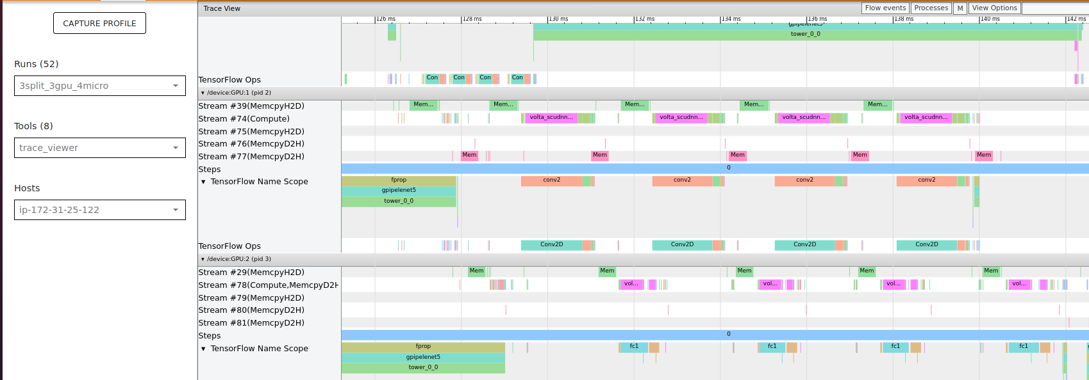
Same as prev except 3 splits..

Slide 30
Where to improve?
Better partitioning algorithm (currently manual)
Any rescheduling of operations? Possibly reschedule re-computations such that parallelism is maximized
Try placing most complex operations in first and last partitions?

